Slide 1
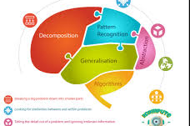
Computational thinking
Year 12

Slide 2

Objectives
Students should be able to:
Show an understanding of abstraction
Describe and use decomposition

Slide 3

What is computational thinking?
Computational thinking is a problem-solving methodology that involves thinking of a solution to a problem based on how the computer would solve it.
It involved in breaking down complex problems into simpler, more manageable parts, and devising solutions by using algorithmic and logical reasoning.

Slide 4

Techniques used of computational thinking
There are several techniques used in computational thinking
Decomposition
Pattern recognition
Abstraction
Algorithm Thinking

Slide 5

decomposition

Slide 6
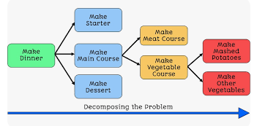
decomposition
This involves identifying the key components and understanding of a problem and how they relate to each other so that it can be broken down a problem into smaller, more manageable sub-problems.
Each sub-problem is then solved independently, and the solutions are combined to solve the overall problem.

Slide 7
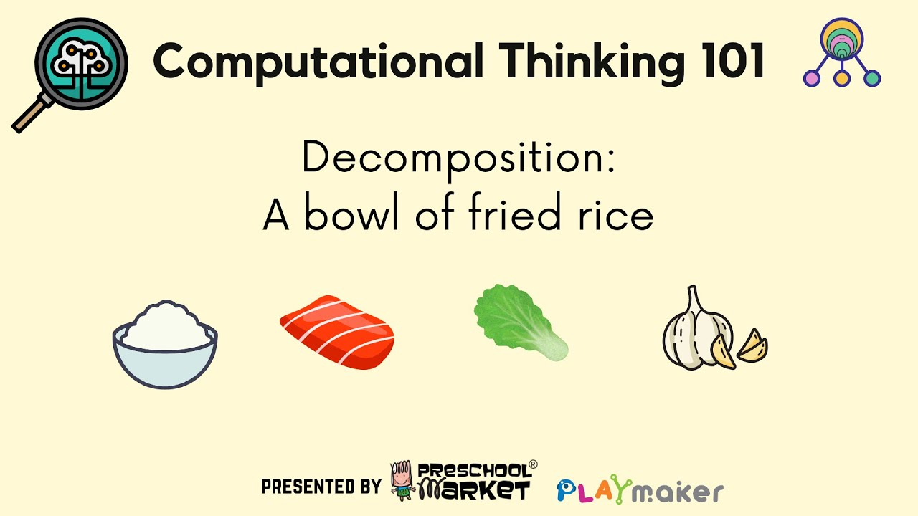
Decomposition-Characteristics
Modularity: Each component addresses a specific aspect of the problem
Parallel Development: different teams or individuals can work on solving different sub-problems simultaneously, allowing for faster overall and more efficient solution.
Reusability: Solutions to sub-problems can often be reused, promoting code reuse and efficiency.
Simplification: Decomposing a complex problem simplifies the problem-solving process by breaking it into more understandable and manageable

Slide 8
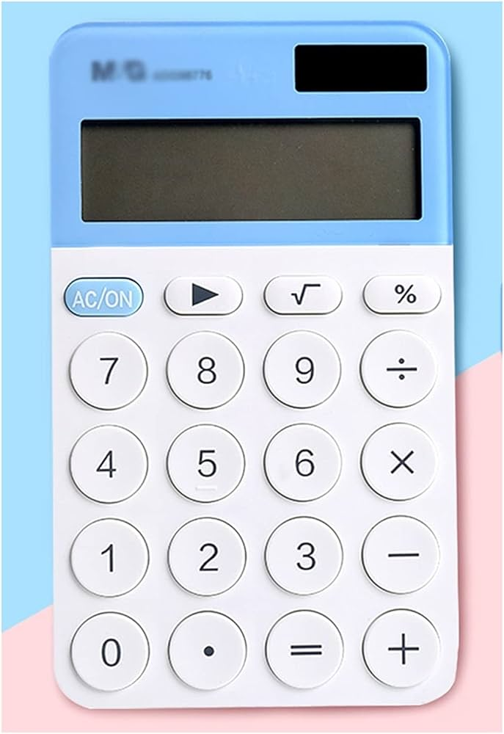
Activity
For the following problem outline the structure of how you would solve it.
"Building a Simple Calculator Program.
Decompose the problem by creating a task list for the solution.
Each group/individual should write a code for that specific area (decomposed) and then put the written code together to for the whole solution.

Slide 9

Pattern recognition is a field of study that involves the identification and interpretation of patterns in data. Identifying patterns or trends within a problem, this involves seeing the similarities or commonalities. The goal is to create models or algorithms that can automatically recognize and categorize these patterns.
Pattern recognition

Slide 10
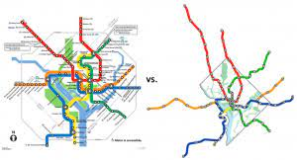
abstraction
Simplifying a problem and focusing on the essential details while ignoring unnecessary information (intricacies).

Slide 11
Abstraction-Characteristics
Promotes modularity by breaking down a system into manageable components.
Creates portable solutions. By hiding hardware-specific details behind abstraction layers, software can be developed to run on different platforms without significant modification, enhancing cross-platform compatibility.
Facilitates communication among team members with different expertise. Allows individuals from different area to collaborate as they can focus on the shared abstraction rather than the details specific to their domains.
Debugging is easier. It reduces the scope of potential issues. No in-depth understanding of the entire system, making it easier to identify and fix problems.

Slide 12
Algorithmic Thinking
Developing a step-by-step solution or a set of instructions to solve a problem. Algorithms provide a clear, unambiguous sequence of steps to follow in order to achieve a specific goal.
It involves breaking down a problem into a sequence of well-defined, logical steps or procedures that, when followed, lead to a solution.

Slide 13
Algorithmic Thinking
There are several methods of writing algorithms before attempting to program
a solution.
Three methods that can be used.
Structured English is a form of pseudocode that uses a subset of the English language with a formal structure to describe the logic of a computer program or algorithm. These steps can be numbered.
Flowcharts use shapes and arrows to illustrate the flow of control and decision points in the algorithm.
Pseudocode is a mix of natural language and simple code-like syntax that helps outline the logic of the algorithm . Not programming language specific.

Slide 14
Activity
Problem:
You are tasked with designing an algorithm for a simple online library system. The system needs to perform the following operations:
Allow a user to log in.
Display a list of available books.
Allow a user to borrow a book.
Display the user's borrowed books.
Allow a user to return a book.
Design an algorithm that outlines the steps and logic for this online library system.
Provide solutions using
Structured English,
a flowchart,
pseudocode.
Finally, a programming code using either Python, VB Net or Java

Slide 15
Structured English
Example
1 Ask for the number of values
2 Loop that number of times
3 Enter a value in loop
4 Add the value to the Total in loop
5 Calculate and output average

Slide 16
pseudocode
START
READ InputValue
IF InputValue > 0 THEN
PRINT "The number is positive."
ELSE
PRINT "The number is non-positive."
ENDIF
FOR i FROM 1 TO 5
PRINT "Iteration ", i
ENDFOR
CALL DisplayResult()STOP

Slide 17
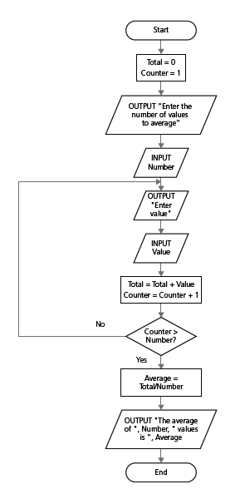
flowchart

Slide 18




Programming constructs

Slide 19
Programming Constructs
A programming construct is a defined algorithm structure that is used to control the order (flow) in which statement are executed.
Sequence tells the CPU (processor) which statement is to be executed next.
Repetition/iteration/Loops/cycle causes a group of one or more program statements to be done repeatedly until some end condition is met.
Selection/Branching provides for selection between alternatives, alternative as in available route options for instruction execution.

Slide 20
If statement
If statements are a fundamental building block of computer programming and are used to make decisions based on conditions.
The “If” statements are always used with a condition/decision.
The condition is evaluated first before executing any statement inside the body of the If.
The syntax of an if statement is as follows:
IF <condition>
THEN
<statements>
ENDIF
Note
The THEN and ELSE clauses are only indented by two spaces. (They are, in a sense, a continuation of the IF statement rather than separate statements.

Slide 21
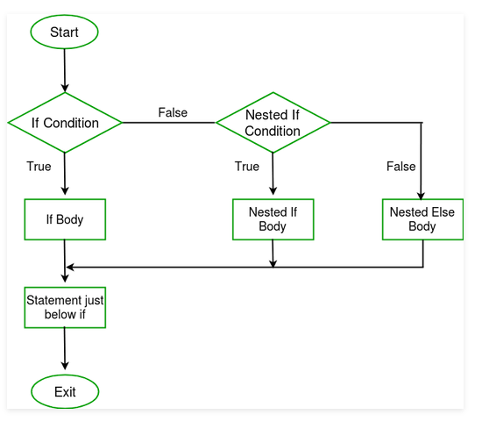
Nested IF statements
It is also possible to include multiple conditions and actions using "else if" statements.
When there is more than one condition and they are dependent on one another, then the nested if statement can be use to check multiple conditions one after another.
The number you can use is not limited but the inner if statement will only execute when it’s outer if statement is true.

Slide 22
Case of
CASE statements allow one out of several branches of code to be executed, depending on the value of a variable.
CASE statements are written as follows:
CASE OF <identifier>
<value 1> : <statement>
<value 2> : <statement>
...
ENDCASE
An OTHERWISE clause can be the last case:
CASE OF <identifier>
<value 1> : <statement>
<value 2> : <statement>
...
OTHERWISE <statement>
ENDCASE

Slide 23
Iterating Construct
Loops/ Iteration

Slide 24
Iteration/Loop
The iteration construct also called looping will cause a set of statements (the body) to be executed repeatedly until some condition is met.
Instead of writing out the same lines of code again and again, a programmer can write a section of code once, and ask the program to execute it again and again until it is no longer needed.

Slide 25
TYPES
Two types
Count-controlled iteration/loop used whenever the number of times a loops needs to execute is known or can be calculated beforehand
Condition-controlled iteration/loop. Will do several instruction based on a given decision/condition.

Slide 26
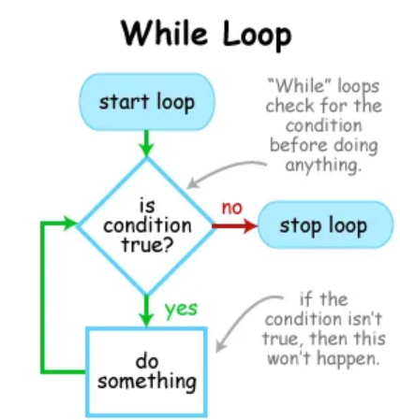
Pre-Condition (While)
The "while loop" is referred to as a "pre-condition loop" because it checks a condition before executing the loop body.
The loop will only execute if the condition is initially true. The loop terminates when the condition evaluates to FALSE.

Slide 27
While do …. Practice
Write a pseudocode algorithm that:
asks the user to input 10 numbers
adds them together
outputs the result

Slide 28
Repeat .. Until
Repeat loops function in the same way as while loops with one major difference - the condition is tested at the end of the loop
The REPEAT statement is at the start of the loop.
The UNTIL statement tests the condition at the end,.
The code within the loop is always executed at least once, even if the result of the test is FALSE because it test the condition after

Slide 29
Repeat Until
REPEAT
OUTPUT "Please enter the password"
INPUT Password
UNTIL Password = "Secret
REPEAT
<Statements>
UNTIL <condition>

Slide 30
Repeat…. Until Practice
Re the while pseudocode using the repeat until construct
Write a pseudocode algorithm that:
asks the user to input 10 numbers
adds them together
outputs the result

